Slide 1
Swarm Robotics Workshop
Dr. Andrew Vardy
Bio-inspired Robotics (BOTS) Lab
Department of Computer Science
Department of Electrical and Computer Engineering
Memorial University of Newfoundland
St. John’s, Canada

Slide 2
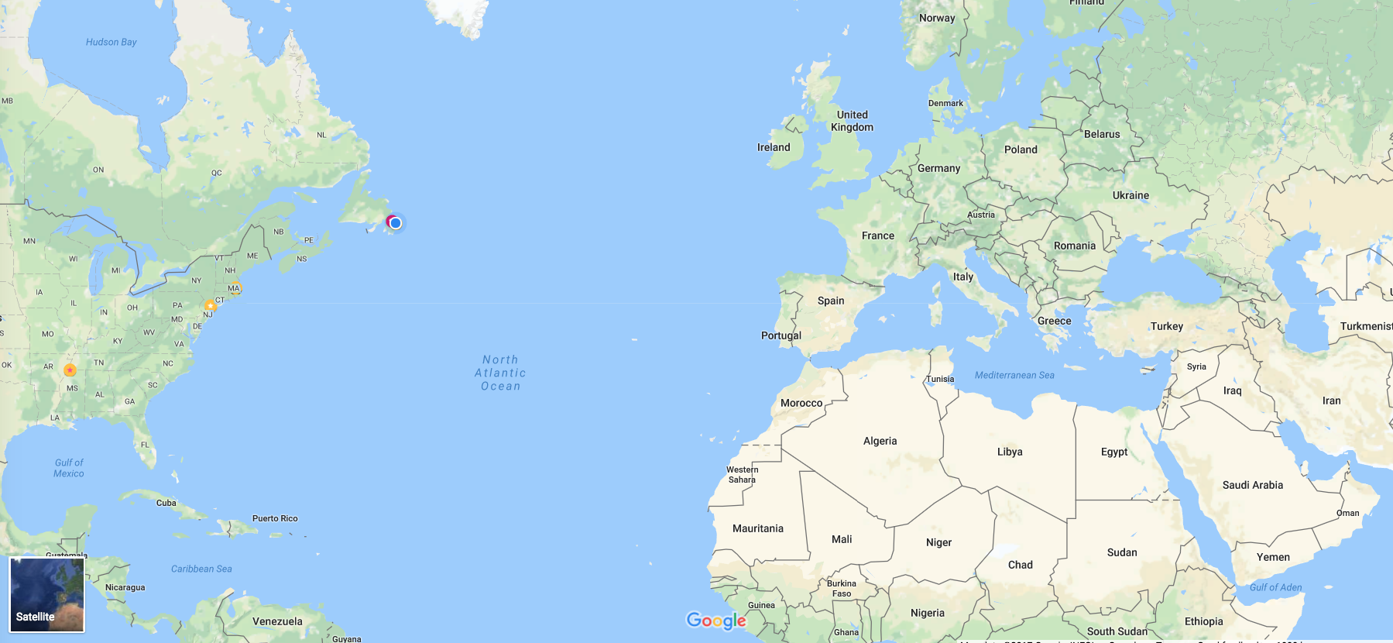
Where I’m from
St. John’s, Canada

Slide 3
Swarm Robotics?
“Swarm robotics is the study of how a large number of relatively simple physically embodied agents can be designed such that a desired collective behavior emerges from the local interactions among the agents and between the agents and the environment.”
[Şahin, E. (2004). Swarm robotics: From sources of inspiration to domains of application. In International workshop on swarm robotics (pp. 10-20). Springer, Berlin, Heidelberg.]

Slide 4
“Swarm robotics is the study of how a large number of relatively simple physically embodied agents can be designed such that a desired collective behavior emerges from the local interactions among the agents and between the agents and the environment.”

Slide 5
“Swarm robotics is the study of how a large number of relatively simple physically embodied agents can be designed such that a desired collective behavior emerges from the local interactions among the agents and between the agents and the environment.”

Slide 6
“Swarm robotics is the study of how a large number of relatively simple physically embodied agents can be designed such that a desired collective behavior emerges from the local interactions among the agents and between the agents and the environment.”
robots

Slide 7
Kilobots: 1024
S-bots: 10-20
Many
limited
robots
Fewer, more capable robots
“Swarm robotics is the study of how a large number of relatively simple physically embodied agents can be designed such that a desired collective behavior emerges from the local interactions among the agents and between the agents and the environment.”
robots

Slide 8
“Swarm robotics is the study of how a large number of relatively simple physically embodied agents can be designed such that a desired collective behavior emerges from the local interactions among the agents and between the agents and the environment.”

Slide 9
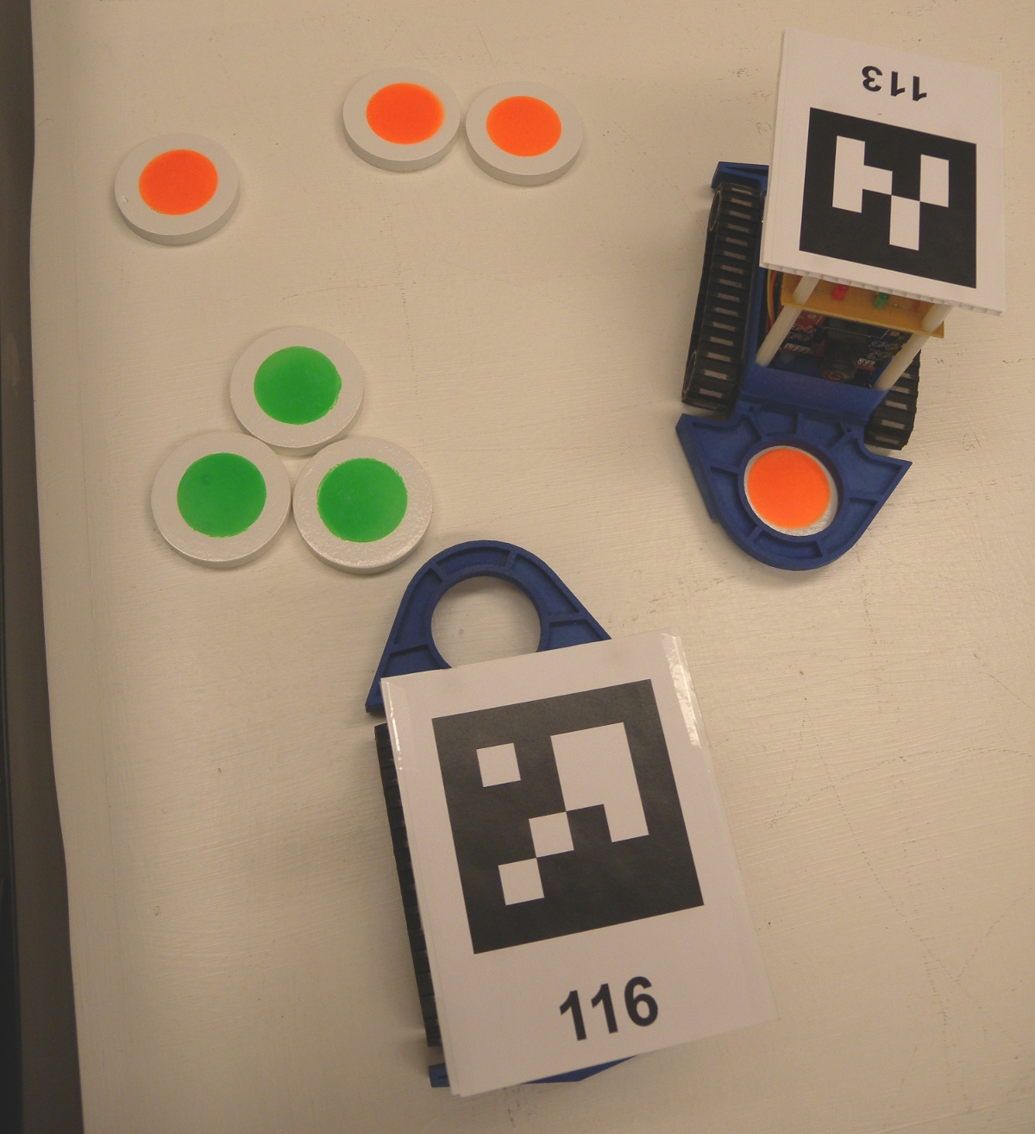
Indirect communication (perceive results of others actions)
Direct communication (local)
“Swarm robotics is the study of how a large number of relatively simple physically embodied agents can be designed such that a desired collective behavior emerges from the local interactions among the agents and between the agents and the environment.”

Slide 10
Characteristics of Swarm Robotics
Swarm Robotics: A multi-robot system with the following characteristics:
robots are autonomous;
robots are situated in the environment and can act to modify it
robots’ sensing and communication capabilities are local
robots do not have access to centralized control and/or to global knowledge
robots cooperate to tackle a given task
Brambilla, M., Ferrante, E., Birattari, M., & Dorigo, M. (2013). Swarm robotics: a review from the swarm engineering perspective. Swarm Intelligence, 7(1), 1-41.

Slide 11
X
X
X
robots are autonomous;
robots are situated in the environment and can act to modify it
robots’ sensing and communication capabilities are local
robots do not have access to centralized control and/or to global knowledge
robots cooperate to tackle a given task
X
X
X

Slide 12
Definition:
“Swarm robotics is the study of how a large number of relatively simple physically embodied agents can be designed such that a desired collective behavior emerges from the local interactions among the agents and between the agents and the environment.”
Characteristics:
robots are autonomous;
robots are situated in the environment and can act to modify it
robots’ sensing and communication capabilities are local
robots do not have access to centralized control and/or to global knowledge
robots cooperate to tackle a given task
What robots exist that adhere to this definition and exhibit these characteristics?

Slide 13
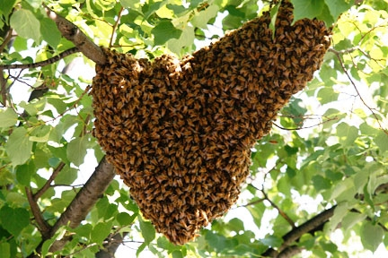
Natural Robots: The Honeybees
Democratic nest selection
Seeley, T. D. (2010). Honeybee democracy. Princeton University Press.
Waggle dance communication

Slide 14
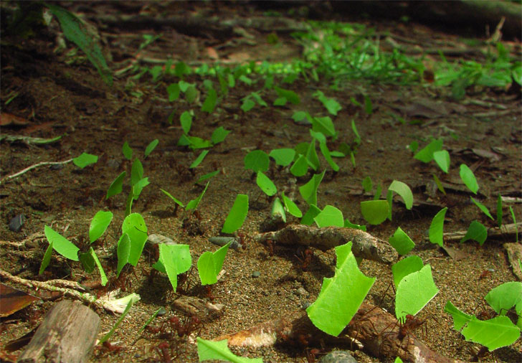
NATURAL ROBOTS: THE ANTS
Extremely successful family
15 - 20% of terrestrial biomass
Leafcutter ants
Invented agriculture millions of years before us!

Slide 15
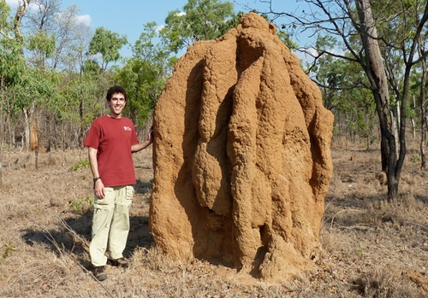
Natural Robots: The termites
Termite mounds taller than a computer scientist
Construct extremely sophisticated structures…

Slide 16
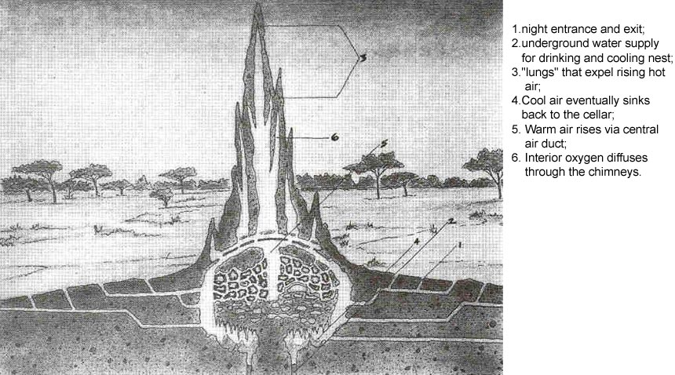
Sophisticated architecture and engineering from insects with small brains, poor vision, and no central coordination

Slide 17
SELF-ORGANIZATION
“Self-organization is a set of dynamical mechanisms whereby structures appear at the global level of a system from interactions among its lower-level components. ”
Bonabeau, E., Dorigo, M., & Theraulaz, G. (1999). Swarm intelligence: from natural to artificial systems
Individual ants, bees, termites, and robots interact locally… yet a global pattern emerges
THE CENTRAL MYSTERY!

Slide 18
Our tools: Blockly and Waggle

Slide 19
waggle
We will be using Waggle, an online simulation and programming environment
2-D Physics: Matter.js
Visual programming: Blockly
There are other tools for simulating swarms of robots:
Agent-based simulators: Netlogo, MASON
Robot simulators: ARGoS, V-REP, Gazebo
Why another simulation tool?

Slide 20
Realistic
Gazebo
V-REP
ARGoS
Waggle
Abstract
MASON
Netlogo
Flexible
Easy to Use

Slide 21
Blockly
A library for building visual programming apps
Started by Google, now open-source
Used for hundreds of educational apps on the web and on Android / iOS devices
Programming for kids?
Yes
”But we’re not kids”
Blockly is an easily learned language for people with various levels of programming experience

Slide 22
Exercise #1: Blockly Games 20 minutes
Go to Blockly Games:
https://blockly-games.appspot.com/
Complete “Puzzle”
Complete as many levels as you can of “Maze”
Experienced programmers:
There are interesting challenges as you progress into the higher levels

Slide 23
Robotics Concepts

Slide 24
The SENSE / ACT Cycle
Robots exist in a constant cycle of perception (via sensors) and movement (via actuators)
Sense
Robot
World
Sensors
Actuators
Act

Slide 25
Sense
Model
Plan
Act
Sense
World
Sensors
Actuators
Act
The robot’s controller may be very deliberative
Carefully build a model of the world, plan a trajectory, then execute it

Slide 26
Or the controller may be reactive
There is a direct mapping of sensor states to actions
The model (if any) is small
We will be using
reactive controllers
Sense
Act
Sense
World
Sensors
Actuators
Act

Slide 27
Tutorial Level

Slide 28
The waggle PAGE
Go to the main Waggle page:
http://bots.cs.mun.ca/waggle/
Note that these slides are available here
Select the Tutorial level
Take note of the following features…

Slide 29
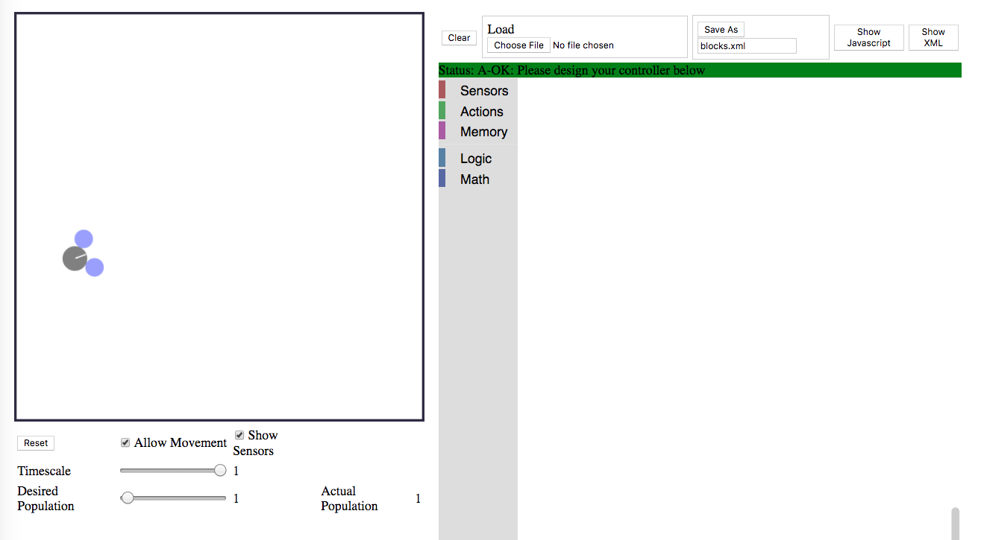
}
Robot-specific Blockly categories
Simulation area
Robot (try click and drag)
Blockly area

Slide 30
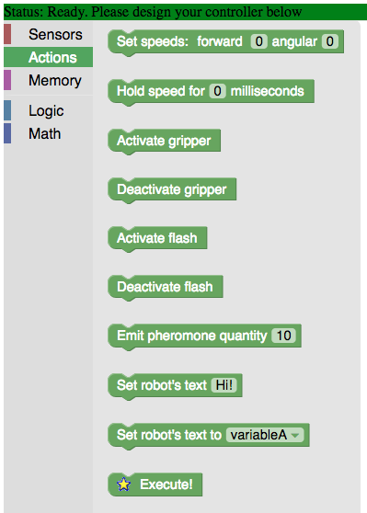
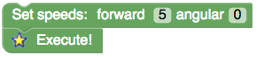
Within the Blockly area, click on the “Actions” category
Now click-and-drag on “Set speeds” and pull it into the open white area
Click on the ‘0’ next to “forward” and change it to some number in the range [-10, 10]
Robot does not move
Click-and-drag “Execute” beneath “Set speeds” so that they connect like this:
Now the robot moves!

Slide 31
Our first controller!
So this is our first controller:
A controller senses the world, then acts
But this controller is so basic, it doesn’t even do any sensing
The controller is executed by the simulator many times per second
There is no need for a “loop”, the controller gets called over-and-over by default

Slide 32
Our first controller!
So this is our first controller:
A controller senses the world, then acts
But this controller is so basic, it doesn’t even do any sensing
The controller is executed by the simulator many times per second
There is no need for a “loop”, the controller gets called over-and-over by default

Slide 33
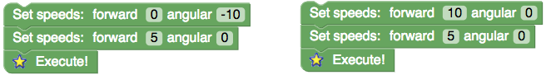
Deferred Execution
Notice how the robot did not move without “Execute”
The controller uses a deferred execution model, meaning that nothing happens until “Execute”. The controller is executed top-to-bottom and each block in the “Actions” category sets something about the action the robot will take. However, no action is taken until “Execute”.
e.g. The following controllers all behave the same because the speeds set by the blocks on the bottom overwrite the speeds set above:

Slide 34

Exercise #2: BASIC MOVEMENT 5 minutes
Experiment with “Set speeds” to derive controllers that travel in...
Straight lines
Circles
Note the importance of
Experiment with positive / negative speeds
Try the following:
Counter-clockwise circle, moving forwards
Counter-clockwise circle, moving backwards

Slide 35
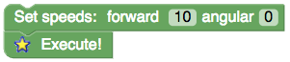
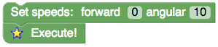
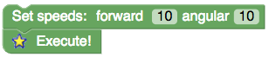
Exercise #2: Review
Move forward (speed 10):
Turn clockwise (speed 10):
Set angular speed negative for counter-clockwise turns
Move in a tight clockwise circle:
Reduce angular speed for a larger circle; Reduce forward speed for a smaller circle
Use negative values for backward motion and counter-clockwise turns

Slide 36
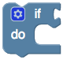
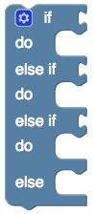
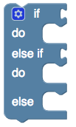
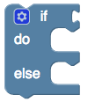
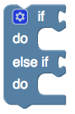
The Conditional BLOCK
Under “Logic” select the conditional block:
Connected to the top part will be a condition block which must evaluate to True or False
If the condition block is True, the block(s) within the “do” will execute
Click on the star to customize this block. Here are some possibilities:

Slide 37
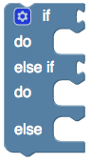
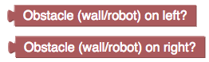


Conditional + SENSORS
Create an if – else if – else conditional block:
Select the “Sensors” category and drag in these two blocks:
Now under the “Actions” category drag in two of these:
Also under “Actions” drag in an

Slide 38
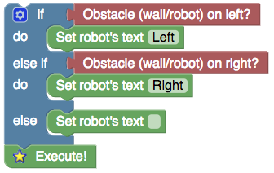
Connect the blocks together like this:
Note that you have to customize the text for each “Set robot’s text” block
Drag the robot around, bumping into the walls to test it

Slide 39


Exercise #3: OBSTACLE AVOIDANCE 5 minutes
Replace the blocks with blocks and adjust the speeds to achieve this:
Note: Should still work when bouncing against walls on the right
Conditions:
Should work with any number of robots

Slide 40
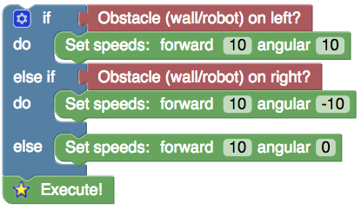
Exercise #3: Review
Your solution should look something like this:
You could reduce the speeds a little, but the robot might hit the wall (not a big problem)

Slide 41
WAGGLE: TOUR OF FEATURES AND BLOCKS

Slide 42
Waggle Feature / Block Tour
Continuing on the Tutorial level, we will introduce some further features of the waggle page...

Slide 43
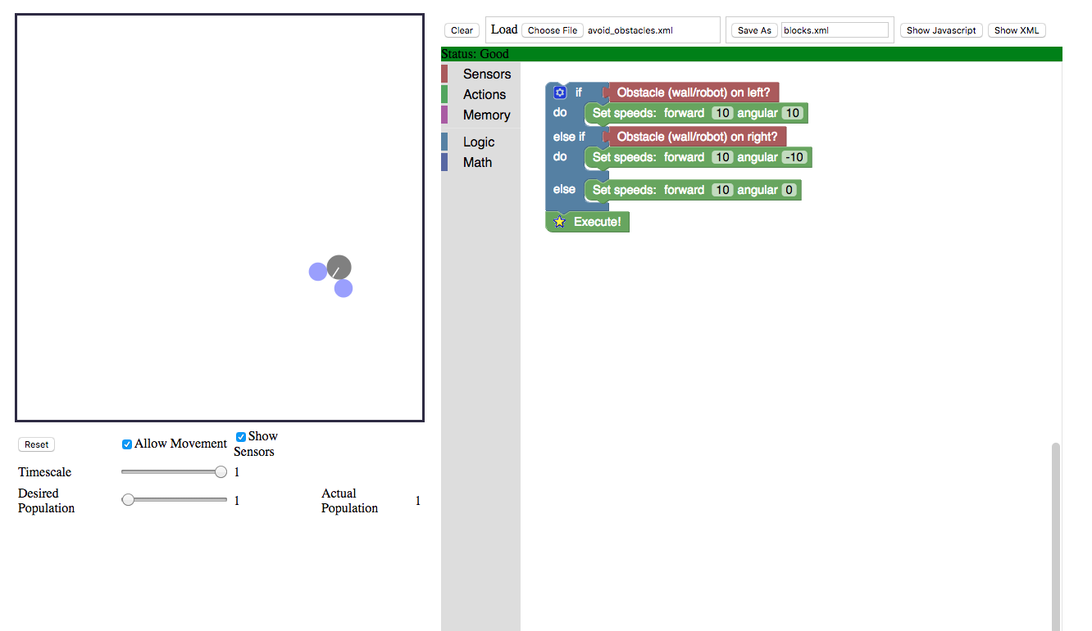
Try adding more robots with
this slider

Slide 44
Try adjusting this slider to see the simulation run in slow-motion
NOTE: Adjusting “Timescale” breaks up movement into smaller increments; This changes the sim’s behaviour and is therefore not exactly the same as “slowing time”.

Slide 45
Use these buttons to save and load your controller.
When saving, the file saved will be set in this box
and it will always be saved into your Downloads folder.
Save your controllers throughout the workshop and give them sensible names. If you hit the browser’s refresh button, the current controller will be lost!

Slide 46
Waggle Feature / Block Tour
Our next major topic is Object Clustering
Prior to introducing the swarm robotics perspective on this, we will take a tour through the features and blocks needed for clustering
Go to the main Waggle page (or just hit your browser’s back button):
http://bots.cs.mun.ca/waggle/
Select the Pre-clustering level

Slide 47
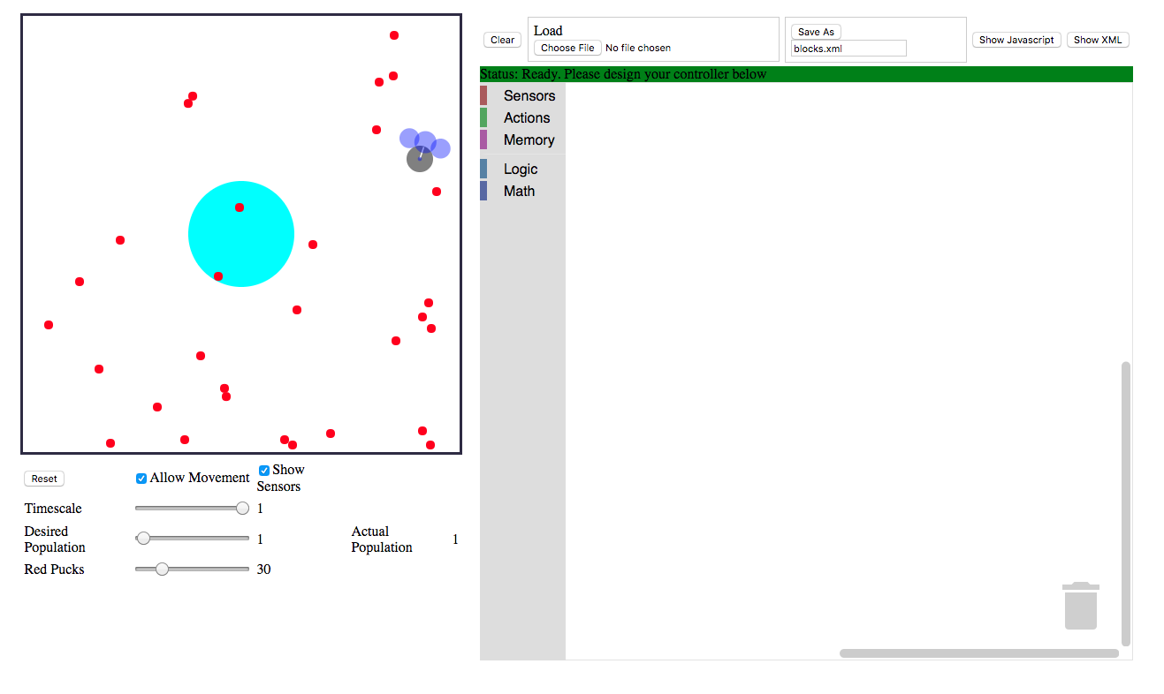
Adjust the number of pucks with this slider. You must hit the “Reset” button for the change to take effect.

Slide 48

Sensors
Sensors are attached to the robot in different configurations; Here is the configuration we will focus on for now:
Note that the obstacle sensors cannot sense pucks and the puck sensor cannot sense obstacles
When a sensor detects its target object, the sensor is shaded red, otherwise it remains blue
Left obstacle (wall or robot) sensor
Robot body
Puck sensor
Right obstacle (wall or robot) sensor

Slide 49


The gripper
The robot can grasp a sensed puck by creating a virtual spring between itself and the puck
Note that the sensor does not detect a grasped puck

Slide 50
DEMO: PUCK COUNT
The main Waggle page has demo controllers that you can load:
http://bots.cs.mun.ca/waggle/
Download grip_and_count.xml
Now go into the Pre-clustering level, click on “Choose File” and load it
Drag the robot around; As soon as it comes close to a puck it will grip it
Notice how it counts (at least up to 4) the number of pucks within sensor’s radius, but not including the puck held

Slide 51
Blockly categories
We will now tour through the various blocks available
You can always get a helpful pop-up on any block by hovering your mouse above it:

Slide 52
“Sensors” Category

Slide 53
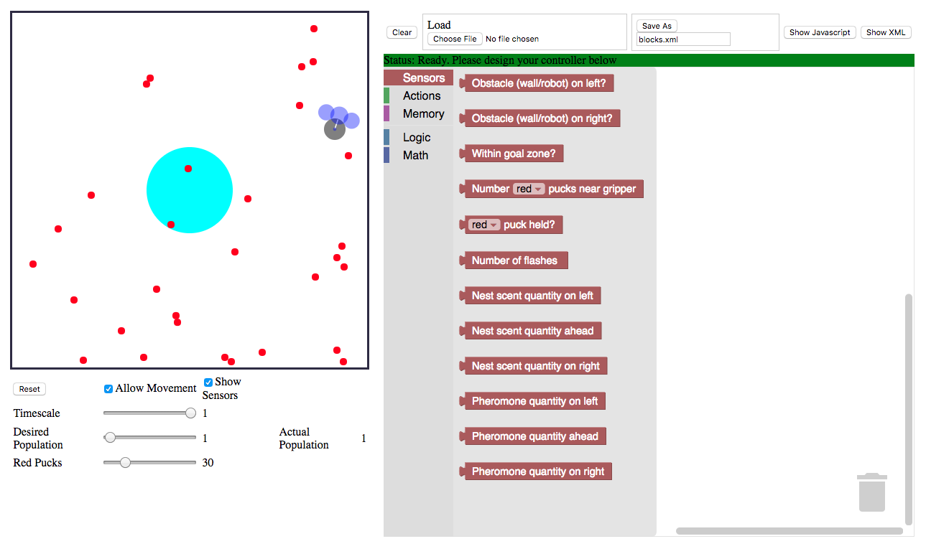
We’ll introduce these now
To be discussed later

Slide 54
We know these blocks.
Note the ? at the end.
This signifies that the block produces a logical value: True or False.

Slide 55
Indicates whether or not the centre of the robot is within the goal zone.

Slide 56
Gives the number of red pucks in the sensor near the gripper.
The result is a number,
not a logical value.

Slide 57
Logical value indicating whether a puck is currently held or not

Slide 58
“ACTIONS” Category

Slide 59
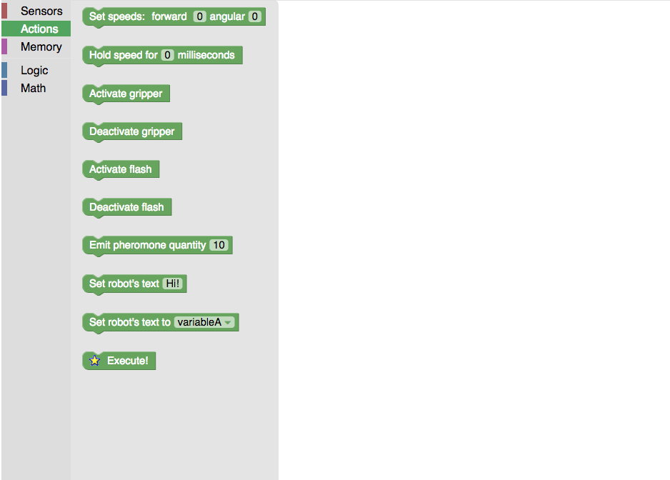
Sets forward and angular speeds (as we’ve seen)
After “Execute”, holds the last commanded speed for this number of milliseconds. Very useful for extended actions such as backing away from something or turning by a desired angle.
Note that while a speed is held, the controller is essentially frozen and cannot receive sensor data.
Activate / deactivate the gripper
Displays the given text on top of the robot
Causes the controller to
execute for one time step

Slide 60
Remaining action blocks will be described later

Slide 61
“LOGIC” Category

Slide 62
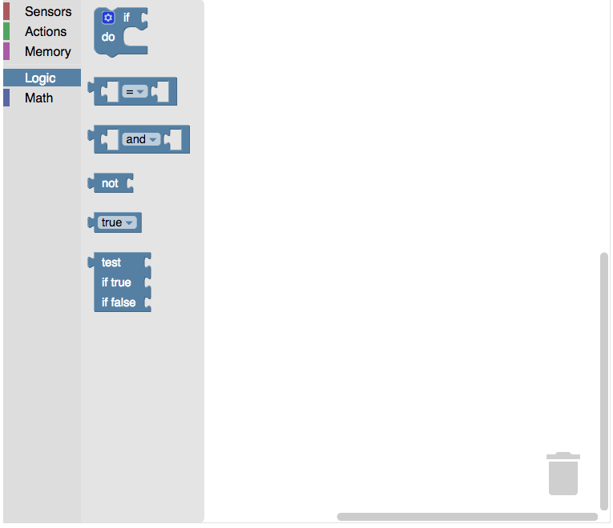
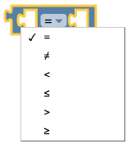
The conditional block. Configure by
clicking star. Super important!
Relational operator. Compares the two number blocks and produces a logical value. By default tests numbers for equality, but this can be configured:

Slide 63
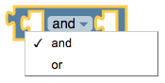
Compares logical values. The two slots are for the logical blocks to compare. By default, produces True only if both values are True, but this can be configured:
and: True only if both inputs are True
or: True if one or both inputs are True

Slide 64
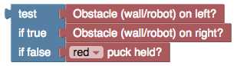
Negates a logical value:
- True becomes False
- False becomes True
Always produces True (or False if selected)
(I’ve never used this... but you might like it)
If the “test” condition is true, returns the same logical value as the “if true” condition. Otherwise, returns the same logical value as
the “if false” condition. e.g. the following commands are equivalent:

Slide 65
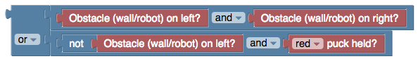
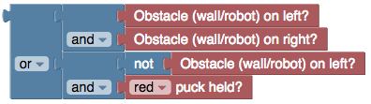
Boolean Expressions
You will sometimes need to form long expressions like this:
By right-clicking and selecting “External Inputs” you can re-format like so...
Applying ”External Inputs” to the sub-blocks we get to this form...

Slide 66
“MATH” Category

Slide 67
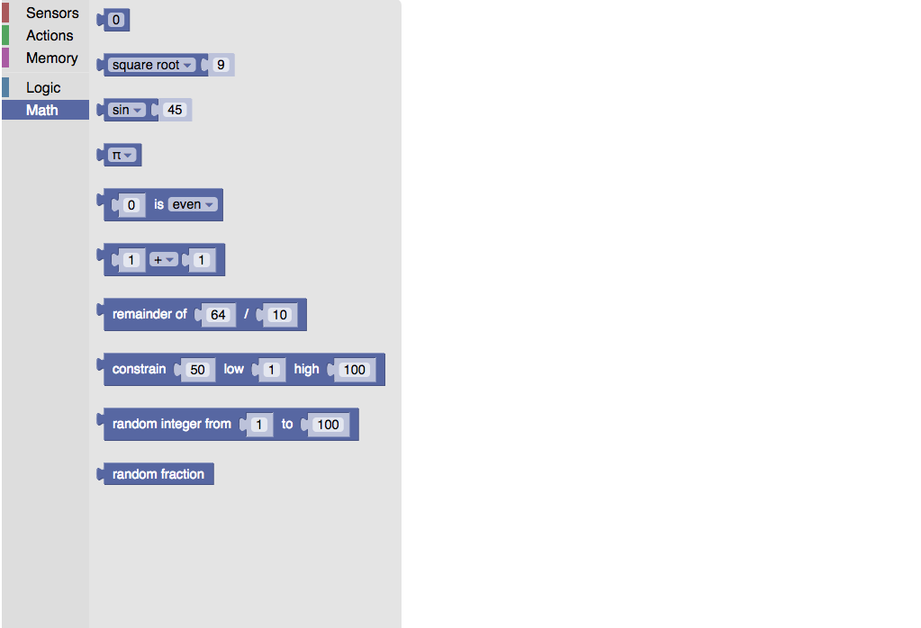
A fixed number
Unary operations on numbers
A fixed special number
Check number property (produces logical value)
Binary operation
Computes remainder after division
Constrains number within limits
Random integer within limits
Random number from 0 to 1

Slide 68
Exercise #4: Don’t bump the pucks! 15 minutes
Start with the obstacle avoidance controller:
In the pre-clustering level create/load this controller; Increase the number of pucks to 100 and hit “Reset”
The robot bumps into the pucks
Your goal is to create a controller that avoids the pucks, bumping into them as little as possible
Conditions:
1 robot

Slide 69
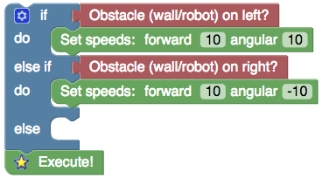
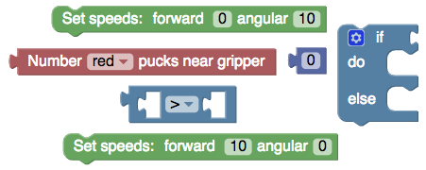
Exercise #4: Don’t bump the pucks! 15 minutes
Modify the controller as follows:
Rearrange the following blocks to go into the empty slot:
The resulting controller won’t be perfect, but it should collide with fewer pucks
Conditions:
1 robot

Slide 70
Exercise #4: Don’t bump the pucks! 15 minutes
Your controller will still probably collide with the occasional puck
Try rearranging your controller and tuning parameters to see if you can further reduce collisions
Conditions:
1 robot

Slide 71
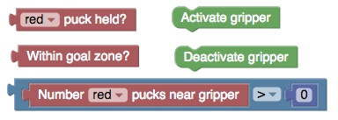
Exercise #5: FORAGING 20 minutes
Write a new controller that wanders about, looking for pucks. Upon encountering a puck it should pick it up. If a robot carrying a puck encounters the goal zone, it should drop it.
You will need the following components (along with others from the obstacle avoidance controller):
CHALLENGES:
Robots may collide with pucks already in the goal zone. How can we handle this?
If using fewer robots, they may not explore the environment fully. How can we handle this?
Conditions:
10 or more robots

Slide 72
OBJECT CLUSTERING

Slide 73
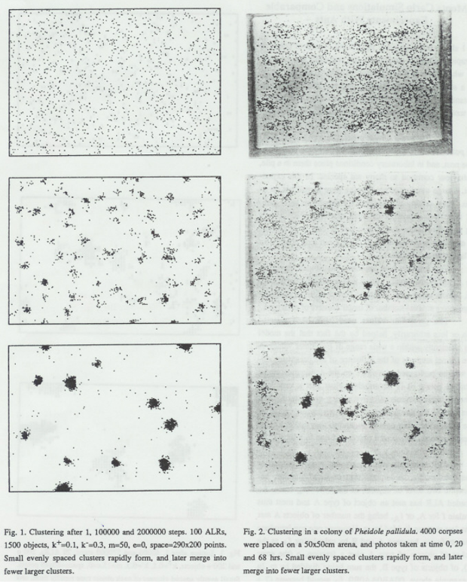
ANT CEMETARY CONSTRUCTION
Biologists have noticed many fascinating examples of social insects organizing their environments
e.g. Colonies of ants will cluster dead ants together, seemingly without any planning or supervision
A computational model was proposed to explain this behaviour:
[Deneubourg, J. L., Goss, S., Franks, N., Sendova-Franks, A., Detrain, C., & Chrétien, L. (1991, February). The dynamics of collective sorting robot-like ants and ant-like robots. In Proceedings of the first international conference on simulation of adaptive behavior on From animals to animats(pp. 356-363).]

Slide 74
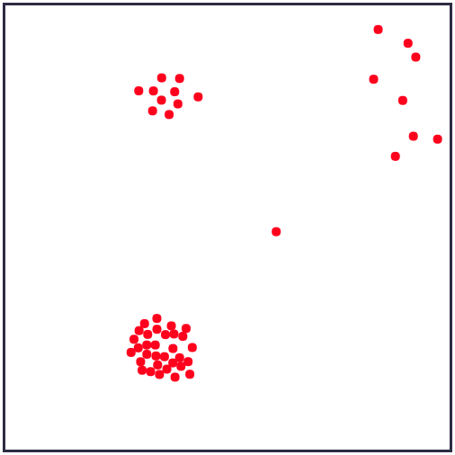
Local object density (cartoon version)
Deneubourg et al’s model:
Agents measure local object density by maintaining a short-term memory and counting the number of recent object appearances
Agents walk randomly and pick-up or deposit objects as a probabilistic function of local object density
Medium
Low
Density | Pick-up Probability (if not carrying) | Deposit Probability (if carrying)
Low | High | Low
High | Low | High
Lower
Zero
High

Slide 75
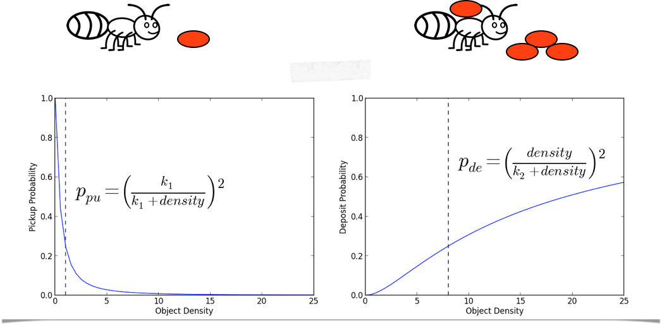
Not carrying
Carrying

Slide 76
Left:
Computer
Model
Right:
Biological
Experiment
Experiments on the computational model closely match the results of biological experiments
But we have to be careful:
Similarity of results does not necessarily imply similarity of method

Slide 77
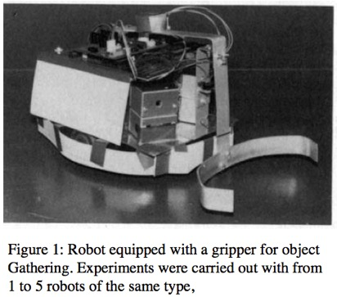
BECKERS ET AL
Beckers et al. wrote a paper detailing their experiments in swarm robotic clustering
Beckers, R., Holland, O. E., & Deneubourg, J. L. (1994, July). From local actions to global tasks: Stigmergy and collective robotics. In Artificial life IV (Vol. 181, p. 189).
Unlike the [Deneubourg et al., 1990] model, the robot’s pick-up / deposit behaviour is implicit

Slide 78
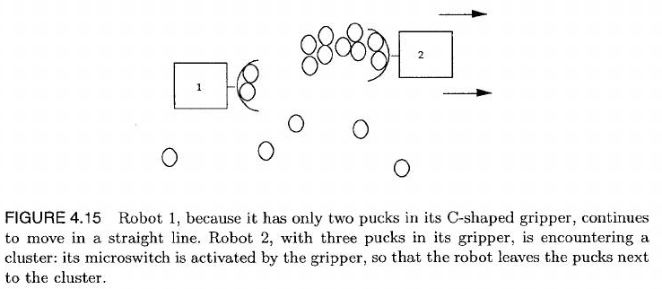
C-shaped gripper passively collects pucks
Infrared sensors detect obstacles (walls, other robots)
Behaviour: Triggers random turn away from obstacle
Force sensor detects that gripper is pushing against three or more pucks
Behaviour: Triggers backup, then a random turn, resulting in the pucks being left behind (i.e. deposited)
If no behaviour is triggered, the robot just moves straight

Slide 79
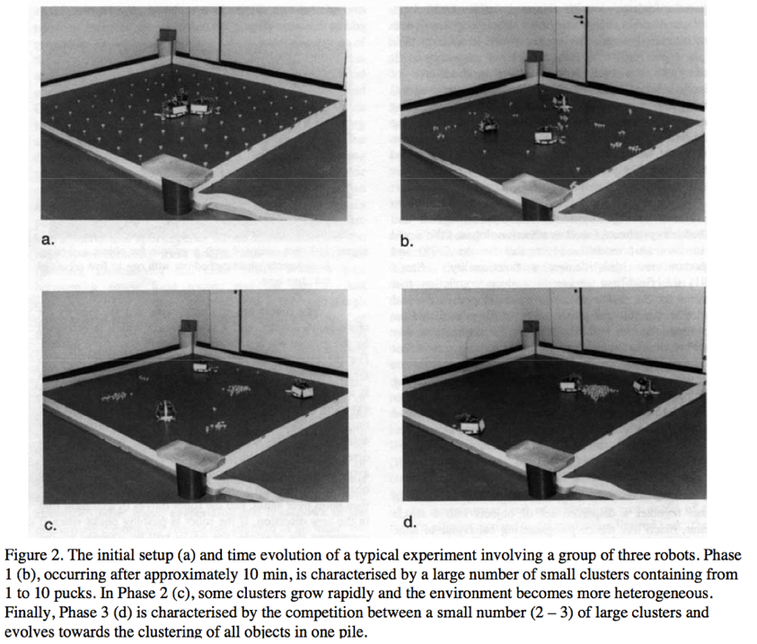
Unlike Deneubourg et al. there is no explicit sensing of local object density
Yet when a high density area is encountered, the robot tends to further increase density by backing up and leaving its pucks behind
POSITIVE FEEDBACK:
Larger clusters are encountered more often, triggering further growth
NEGATIVE FEEDBACK:
When smaller clusters are encountered their pucks are taken away

Slide 80



Clustering in waggle
The next task will be to consider a number of different possible sensor states and decide on reactions for each one
We’ll have to consider different numbers of pucks detected by the robot and decide whether they represent low or high density
For simplicity, lets say that a single puck is low-density and two or more pucks is high-density

Slide 81

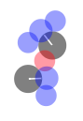
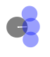
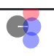


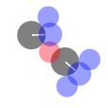
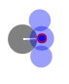
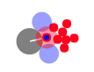
Fill in the blanks with the choices the robot should make; e.g.
Turn right
Pick-up
Straight
Turn right
Turn away
Turn left
Deposit, then
turn away
Straight
Turn left

Slide 82
The answers are shown here:
Notes:
To turn away by a fixed angle, use both “Set speeds” and “Hold speed”
There are conditions not shown such as combinations of obstacles and pucks
Pick-up
Turn right
Straight
Turn right
Turn away
Turn left
Straight
Deposit, then
turn away
Turn left

Slide 83
Exercise #6: OBJECT CLUSTERING 20 minutes
Create a new controller that has the appropriate response for all of the conditions just described
Beneath the simulation controls is a new plot called “Percentage Completion”
Details:
Computes the size of the largest cluster. Let this size be L
PC = 100 * L / (number of pucks)
CHALLENGE:
With 10 robots and 30 pucks, reach 60% completion within 200 seconds
Conditions:
Any number of robots and pucks

Slide 84
NEGATIVE FEEDBACK
Why does this work?
The other behaviours are necessary but only these two have a direct impact
Larger clusters attract more deposits than smaller clusters, leading to further growth and the gradual absorption of smaller clusters:
Kazadi, S., Abdul-Khaliq, A., & Goodman, R. (2002). On the convergence of puck clustering systems. Robotics and Autonomous Systems, 38(2), 93-117.
Pick-up
Turn right
Straight
Turn right
Turn away
Turn left
POSITIVE FEEDBACK
Straight
Deposit, then
turn away
Turn left

Slide 85
Object Sorting

Slide 86
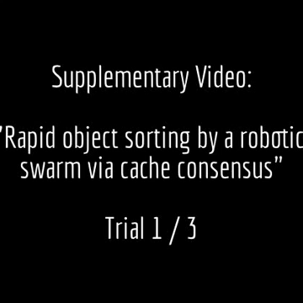
OBJECT SORTING
Sorting objects is a natural extension of clustering
Clustering: One object type
Sorting: Two object types
It has potential applications in recycling, mining, and warehousing
Vardy, A., Vorobyev, G., & Banzhaf, W. (2014). Cache consensus: rapid object sorting by a robotic swarm. Swarm Intelligence, 8(1), 61-87.

Slide 87
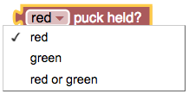

SORTING IN WAGGLE
Go to the main Waggle page (or just hit your browser’s back button):
http://bots.cs.mun.ca/waggle/
Select the Sorting level. Note that there are now two different colours of pucks available: red and green
We will use the same sensor and action blocks as before, but will need to customize the “___ puck held” and “Number _____ pucks” blocks:

Slide 88













When sorting two colors, we have more choices to make
Can you fill in the blanks?
Turn right

Slide 89
Pick-up
Deposit, then
turn away
Turn right
Straight
Straight (breaking
up mixed cluster)
Turn away
Turn left

Slide 90
Exercise #7: OBJECT SORTING 20 minutes
Create a new controller that has the appropriate response for all of the conditions just described
CHALLENGE:
With 10 robots, 30 red pucks, and 30 green pucks, reach 50% completion within 200 seconds
Conditions:
Any number of robots and pucks

Slide 91
Synchronization

Slide 92

Firefly synchronization
Fireflies exhibit a remarkable behaviour where they flash in synchrony, apparently for reproduction
Since different species have different characteristic patterns, when the males flash appropriately the females can tell they have found an appropriate mate

Slide 93


Slide 94

A simplified view
The patterns of flashing in fireflies can be complex
We take the simplified view of fireflies flashing in a single pulse
Exemplified by this video from Thailand:

Slide 95
Why is this of interest to robotics?
Having a swarm of robots flash in synchrony has been proposed as a way to detect failures in other robots:
That one’s not flashing right; It must be broken!
Christensen, A. L., OGrady, R., & Dorigo, M. (2009). From fireflies to fault-tolerant swarms of robots. IEEE Transactions on Evolutionary Computation, 13(4), 754-766.
In general, we’re interested in how distributed agents can agree globally when each of them only has a very limited view of the world
e.g. Agree on a set of locations for coloured pucks

Slide 96



Flashing IN WAGGLE
Go to the main Waggle page (or just hit your browser’s back button):
http://bots.cs.mun.ca/waggle/
Select the Fireflies level. There are no pucks and the robot has lost its puck sensor. But it has a large sensor that can detect flashes from other robots.
In “Sensors”: This gives the number of robots within the sensor’s area that were flashing during the last time step
In “Actions”: These illuminate and de-illuminate the robot

Slide 97
Variables
All of our controllers so far have been completely reactive---behaviour depends only on the present input
But to make regular pulses of light the robots need to store something about the time since the last flash
Variables are a fundamental element in programming, but their use in Waggle is pretty limited:
Only three variables available: variableA, variableB, and variableC
For our purposes we will only need one
They are integers, initialized to start at 0

Slide 98

“Memory” Category
Set the variable to the given integer
Modify the variable by adding the given integer
Get the variable’s value as a number
Display the variable’s value on top of the robot (useful for debugging)

Slide 99

Exercise #8: SIMPLE FLASHING 5 minutes
Create a controller like this:
Add 1 to variableA
If variableA = 10
Activate flash
Set variableA to 0
Else
Deactivate flash
Execute
See what happens when you increase the number of robots
Play with “Timescale” slider to see things in slow motion
Incorporate
Note that robots are “born” at different times, and therefore will not be synchronized by default (although those with the same “birthday” will automatically synchronize)
Conditions:
Any number of robots (not trying to synchronize yet)

Slide 100
Exercise #9: Synchronization 15 minutes
Start with the “fixed flasher” just created
If a neighbouring robot flashes, how should you respond so that you flash at the same time during the next cycle?
Devise your own strategy based on this idea
Drag your robots around so that they form groups
You may wish to deselect “Show Sensors”
You may not get good performance unless the robots “mingle”
Incorporate obstacle avoidance and keep the robots moving while they attempt to sync
Conditions:
Any number of robots

Slide 101
Pheromones

Slide 102

Pheromones: Insect communication
In many cases, insects deposit chemical signals called pheromones which can indicate something about a certain place or thing
The classic example of pheromone use is in ant foraging

Slide 103
Finding the shortest path
When foraging for food, some ants leave behind pheromone trails on the ground:
The pheromone is deposited by ants on their way back to the nest
After the food source is exhausted the pheromone trail will dissipate
Generally ants find the shortest path between food sources and the nest
That’s a big deal! How can these tiny insects solve the problem of finding the shortest path?

Slide 104


Slide 105


Slide 106


Slide 107

This is an example of positive feedback! The shorter branch has more pheromone deposited and therefore attracts the new ant. The new ant will also deposit more pheromone, amplifying the shorter branch even more!

Slide 108


Slide 109

The pheromone deposited on the longer branch evaporates—an example of implicit negative feedback. If the ants forcibly removed the pheromone from that branch then we would say the negative feedback was explicit.

Slide 110

It is important to note that the ants will usually reach a state of consensus, with the majority adopting one of the two branches. This is true even if both branches are the same length.

Slide 111

PHEROMONES IN WAGGLE
Go to the main Waggle page (or just hit your browser’s back button):
http://bots.cs.mun.ca/waggle/
Select the Pheromones level
The robot has a new layout of sensors:
Puck sensor (enlarged)
Three pheromone / nest scent sensors
Left/right obstacle sensors

Slide 112



The “Select grid visibility” dropdown offers three choices:
Green pucks
(Food)
Nest
No grid:
- White background just as before
Show Pheromone Grid:
Displays the quantity of pheromone:
0: Black
1: White
Appears black initially because no pheromone has been deposited
Show Nest Grid:
Displays the quantity of nest scent:
0: Black
1: White

Slide 113
Nest scent?
Once grabbing a puck (food) the robot needs to get it back to the nest
Real ants have a variety of navigation strategies:
Visual homing by comparing the current image with one captured at the nest
Learning their own visual path
Path integration: Integrating velocity over time
We’ll simplify and assume they can somehow smell the nest over a wide area

Slide 114
Each cell has a value in the range [0, 1] corresponding to its distance to the nest:
0 (Black): Cell is at maximum distance to the nest
1 (White): Cell is at the centre of the nest (distance 0)
So the nest scent grid forms a hill with the nest on top
This hill can be climbed by always moving in the direction of the highest sensor value

Slide 115


New blocks
In the “Actions” Category:
Emit this quantity of pheromones (10 by default)
Value is divided by 10 internally
In the “Sensors” Category:
Gives the quantity of either nest scent or pheromone underneath the left, ahead, or right sensor

Slide 116
Exercise #10: HILL CLIMBING 15 minutes
Consider only nest scent, create a controller that moves towards the direction with the greatest nest scent
Once working, incorporate obstacle avoidance
CHALLENGE:
The robot should be able to reach the nest from anywhere
Conditions:
1 robot

Slide 117


Now experiment with this very simple controller by dragging the robot around:
Our goal is to develop a foraging controller which will leave pheromones behind whenever the robot has collected a green puck and is on its way home
Try this controller:
Like the one above, a robot using this controller needs the human user to drag it around. Try using it to collect all of the pucks in each pile:
Notice how a new pile is generated

Slide 118
Exercise #11: Pheromone-Aided foraging 30 minutes
Combine the following ideas to develop a controller that continually searches for green pucks using pheromones and returns with pucks to the nest:
Controller from previous slide
Hill climbing controller (ex. 10) for returning to the nest
Obstacle avoidance
CHALLENGE:
10 robots, 10 pucks: Once the controller is working, determine how long it takes to cycle through all three food piles
Contrast this with the same controller which deposits no pheromones
Conditions:
Any number of robots

Slide 119
Closing thoughts

Slide 120
conclusions
We’ve approached swarm robotics through biologically-inspired examples
Waggle’s version of Blockly is quite limited---yet interesting and complex collective behaviour still emerges
Hopefully you’ve seen that swarm robotics is an engaging and accessible field!
Please let me know of any suggestions for improving Waggle or the experience of newcomers to swarm robotics:
av@mun.ca
bots.cs.mun.ca

Slide 121
Waggle: Known issues / BUGS
”Slots” blocks not working
When the same controller is re-loaded, the load fails
Blockly area sizing
Arrow keys not the best choice for manual control
Pheromones: Robot gets trapped at nest while holding a puck (occurred with 10 robots, 10 pucks)

Slide 122
WAGGLE ISSUES AT KAUST
1 random crash --- page became unresponsive
2 students found that when adding a block, the page would skip backwards to the main waggle page --- thus, eliminating their work
2 students found in the sorting application that the number of robots was decreasing! Number of pucks was also reducing.
1 student found unexpected behaviour due to the speeds being reset to 0; Workaround was to always have a “set speed” for all logical paths
Fireflies: Sensors staying red after flash from neighbour
Pheromones:
Robot carrying puck could get stuck at goal
Emited pheromones overwrite values in the pheromone grid instead of being added to them

